Slide 1

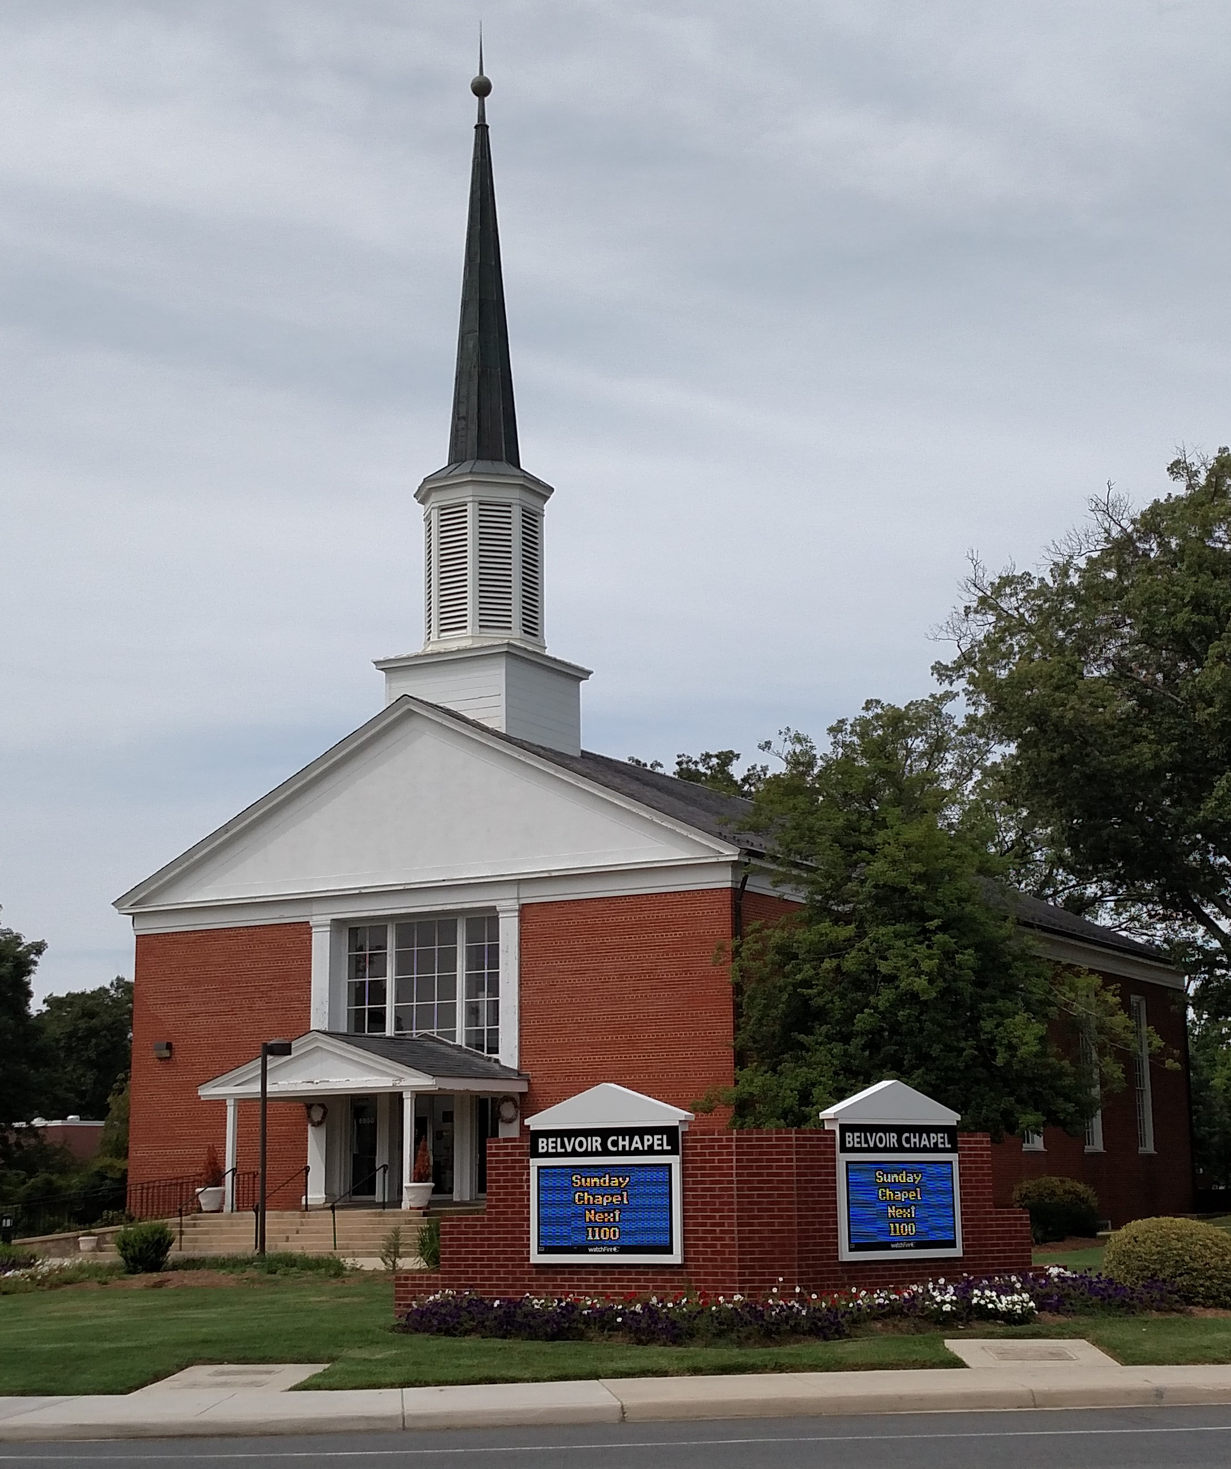
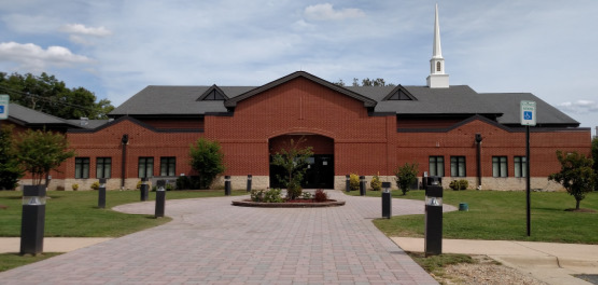
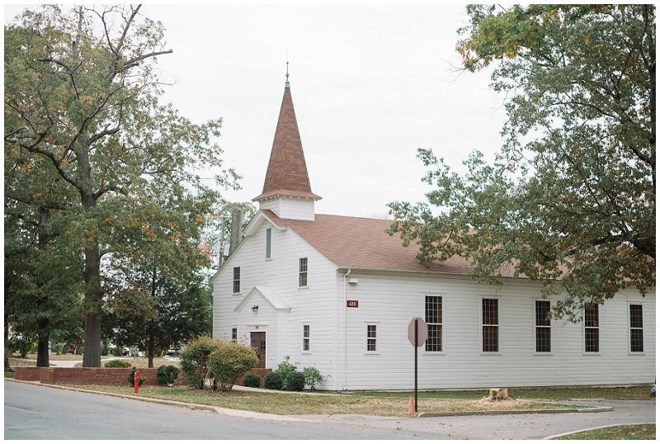
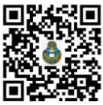

OTHER MINISTRIES
FIVE (5) LOCATIONS
RSO
Religious Support Office
USAG Fort Belvoir, Virginia
Student Ministries
Belvoir Chapel
Thriving middle & high school programs for each faith community on Fort Belvoir comprised of weekly meetings, small groups, retreats, conferences, contemporary worship & other activities.
Office Hours: M-F 0900-1600
5950 12th St, BLDG 1018
Religious Education Center
Office Hours: M-F 0900-1600
5952 12th St, BLDG 1028
*Family Night
**Sunday School
A vital, united, loving faith community living in God given freedom enabling readiness today & tomorrow.
For more information about Youth Ministries call
(703) 806-3418
(202) 934-7061
(703) 806-3958
Catholic
Jewish
Protestant
Fairfax Chapel
SOMETHING
FOR EVERYONE
Belvoir Home School Families
Office Hours: by appointment
5675 21st Street, BLDG 435
(703) 806-5906
For information about Home School Families contact natalie.mack@belvoirhomeeducators.com
Woodlawn Chapel
Office Hours: M-F 0900-1600
1801 Wright Rd, BLDG 1801
Family Life Center
Individual Counseling
Family Counseling
Marriage Counseling
Marriage Enrichment Events
EMDR Therapy
Play Therapy
Chapel Annex
Office Hours: M-F 0900-1600
10011 Middleton Road, BLDG 221
(703) 806-5906
10011 Middleton Rd BLDG 221
To schedule an appointment text
(571) 459-5543
For more general information:
POC: Liz Brown; (703) 806-3316
virginia.e.brown.civ@army.mil
Army Online Giving
As of: 05JAN25

Slide 2
ROMAN CATHOLIC
PROTESTANT
JEWISH
Catholic Mass
Sunday Worship Services
Sabbath Service and Oneg Shabbat
Woodlawn Chapel
1600
Saturday
Friday
Belvoir Chapel
Woodlawn Chapel
Woodlawn Chapel
Belvoir Chapel
1100
0930
1130
Sunday
Traditional
Chapel Next
Gospel
1900
0930
Belvoir Chapel
Torah Service
1100 Fairfax Chapel
Wednesday 1205 Woodlawn Chapel
4th Saturday
Belvoir Chapel
1000
Confessions
Children’s Church
Family Shabbat
1000
Fairfax Chapel
Wednesday
by appointment
2nd Saturday
1115-1145
Woodlawn Chapel
See specific service for details
Religious Education
Religious Education
0930-1230
Sunday
Call for class schedule
Tutoring by appointment
0920-1030
BLDG 221
Sunday School
(Kindergarten to Adult)
Religious Education
REC
Sunday
Catholic Youth meet monthly
call (703) 806-3418
1045-1200
Preschool to Adult
Student Ministries
Adult Hebrew School
1800
Wednesday
Contact: mwilliams@yfc.net
Belvoir Chapel
Online
Monday
0700
Sacrament of Marriage
Supports & celebrates all Jewish holidays. For more information on any of the above Jewish programs, call (202) 934-7061 or visit BLDG 221.
Contact the Catholic Chaplain at least six months prior to sacramental marriage.
AWANA
1600-1745
Sunday
Contact: ftbelvoirawana@gmail.com
(Age 3 to 12th grade during school)
REC
Buddhist
Sacrament of Baptism
Belvoir Men of Faith (BMOF)
Virtual Meeting
POC: Yashika Cook; (571) 231-1549
yashika.r.cook.mil@health.mil
Class held on the first Saturday of the month. Registration is required. To register contact the Catholic Chaplain.
2nd & 4th Saturday
jjrossi01@gmail.com
0730-0900
REC
For more information on Religious Education contact Sister Michael Bochnowski (DRE); (703) 806-3418
smary.m.bochnowski.civ@army.mil
Protestant Women of Chapel
Catholic Women of Chapel
Belvoir Chapel
Thursday
www.pwocfortbelvoir.org
0945
Woodlawn Chapel
Wednesday
Contact: fortbelvoircwoc@gmail.com
0930-1100
Gospel Women of Worship
For more information on Protestant ministries contact
Hye Jin Hwang (DRE); (703) 806-3958
hye.j.hwang.civ@army.mil
Knights of Columbus
1st Saturday
0900
2nd & 4th Thursday
Contact: fbkoc11170@gmail.com
Woodlawn Chapel
Family Night (two 8 week sessions)
Wednesday
For more general information:
POC: Liz Brown; (703) 806-3316
virginia.e.brown.civ@army.mil
For more information on Catholic ministries
www.FortBelvoirCatholicCommunity.com
1800-1930
REC

